Slide 1








Indonesia the untapped destination,
discover the undiscovered
June 30th 2023
Maritime and Coastal Tourism
BPP PHRI Human Development
Alexander Nayoan
Joko Haryono S.Pd., M.Par., CHA

Slide 2


01
The phrase "Indonesia the untapped destination, discover the undiscovered" refers to the immense potential and hidden gems that Indonesia possesses as a tourist destination. It suggests that Indonesia offers unique and lesser-known experiences that are waiting to be explored by Local and International travelers
02
03
"Discover the undiscovered" encourages travelers to venture beyond the popular tourist destinations and explore the lesser-explored regions of Indonesia. It highlights the opportunity to uncover hidden gems, pristine beaches, vibrant local cultures, diverse ecosystems, and off-the-beaten-path experiences that are yet to be fully discovered and appreciated.
"Untapped destination" implies that Indonesia has not yet reached its full potential in terms of tourism development and international recognition. It suggests that there are still many untouched, pristine locations, cultural treasures, cuisine and natural wonders within Indonesia that are relatively unknown to the global tourism industry.

Slide 3



Indonesia Untapped and Undiscovered Tourism
The 4 A to boost Indonesian Tourisme :
Attraction, Accessibility, Amenities, and Ancillary
Basic strategies to be implemented:
Safety and Health Measures
Domestic Tourism Promotion
Sustainable and Responsible Tourism
Digital Marketing and Promotion
Infrastructure Development
Diversification of Tourism Offerings
Strengthen Partnerships
Capitalize on its rich natural landscapes, cultural heritage, and biodiversity.
Nature-based tourism, Cultural tourism, Adventure tourism, Wellness tourism, and Sustainable tourism

Slide 4
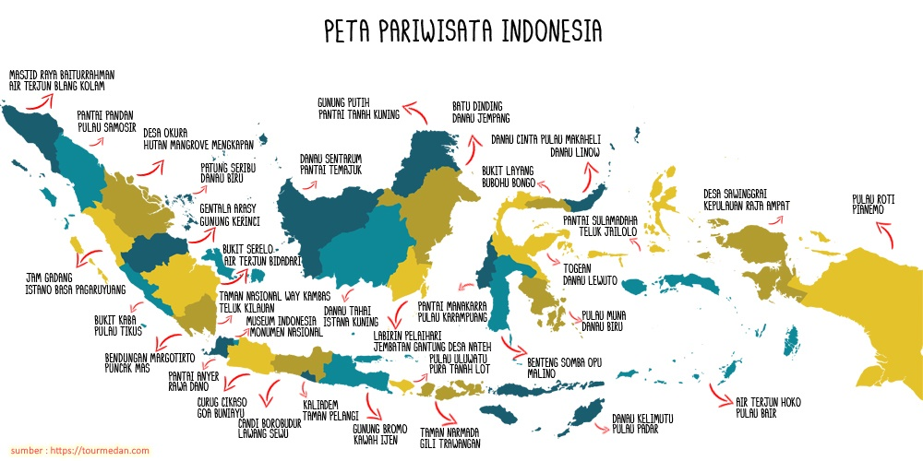

Slide 5
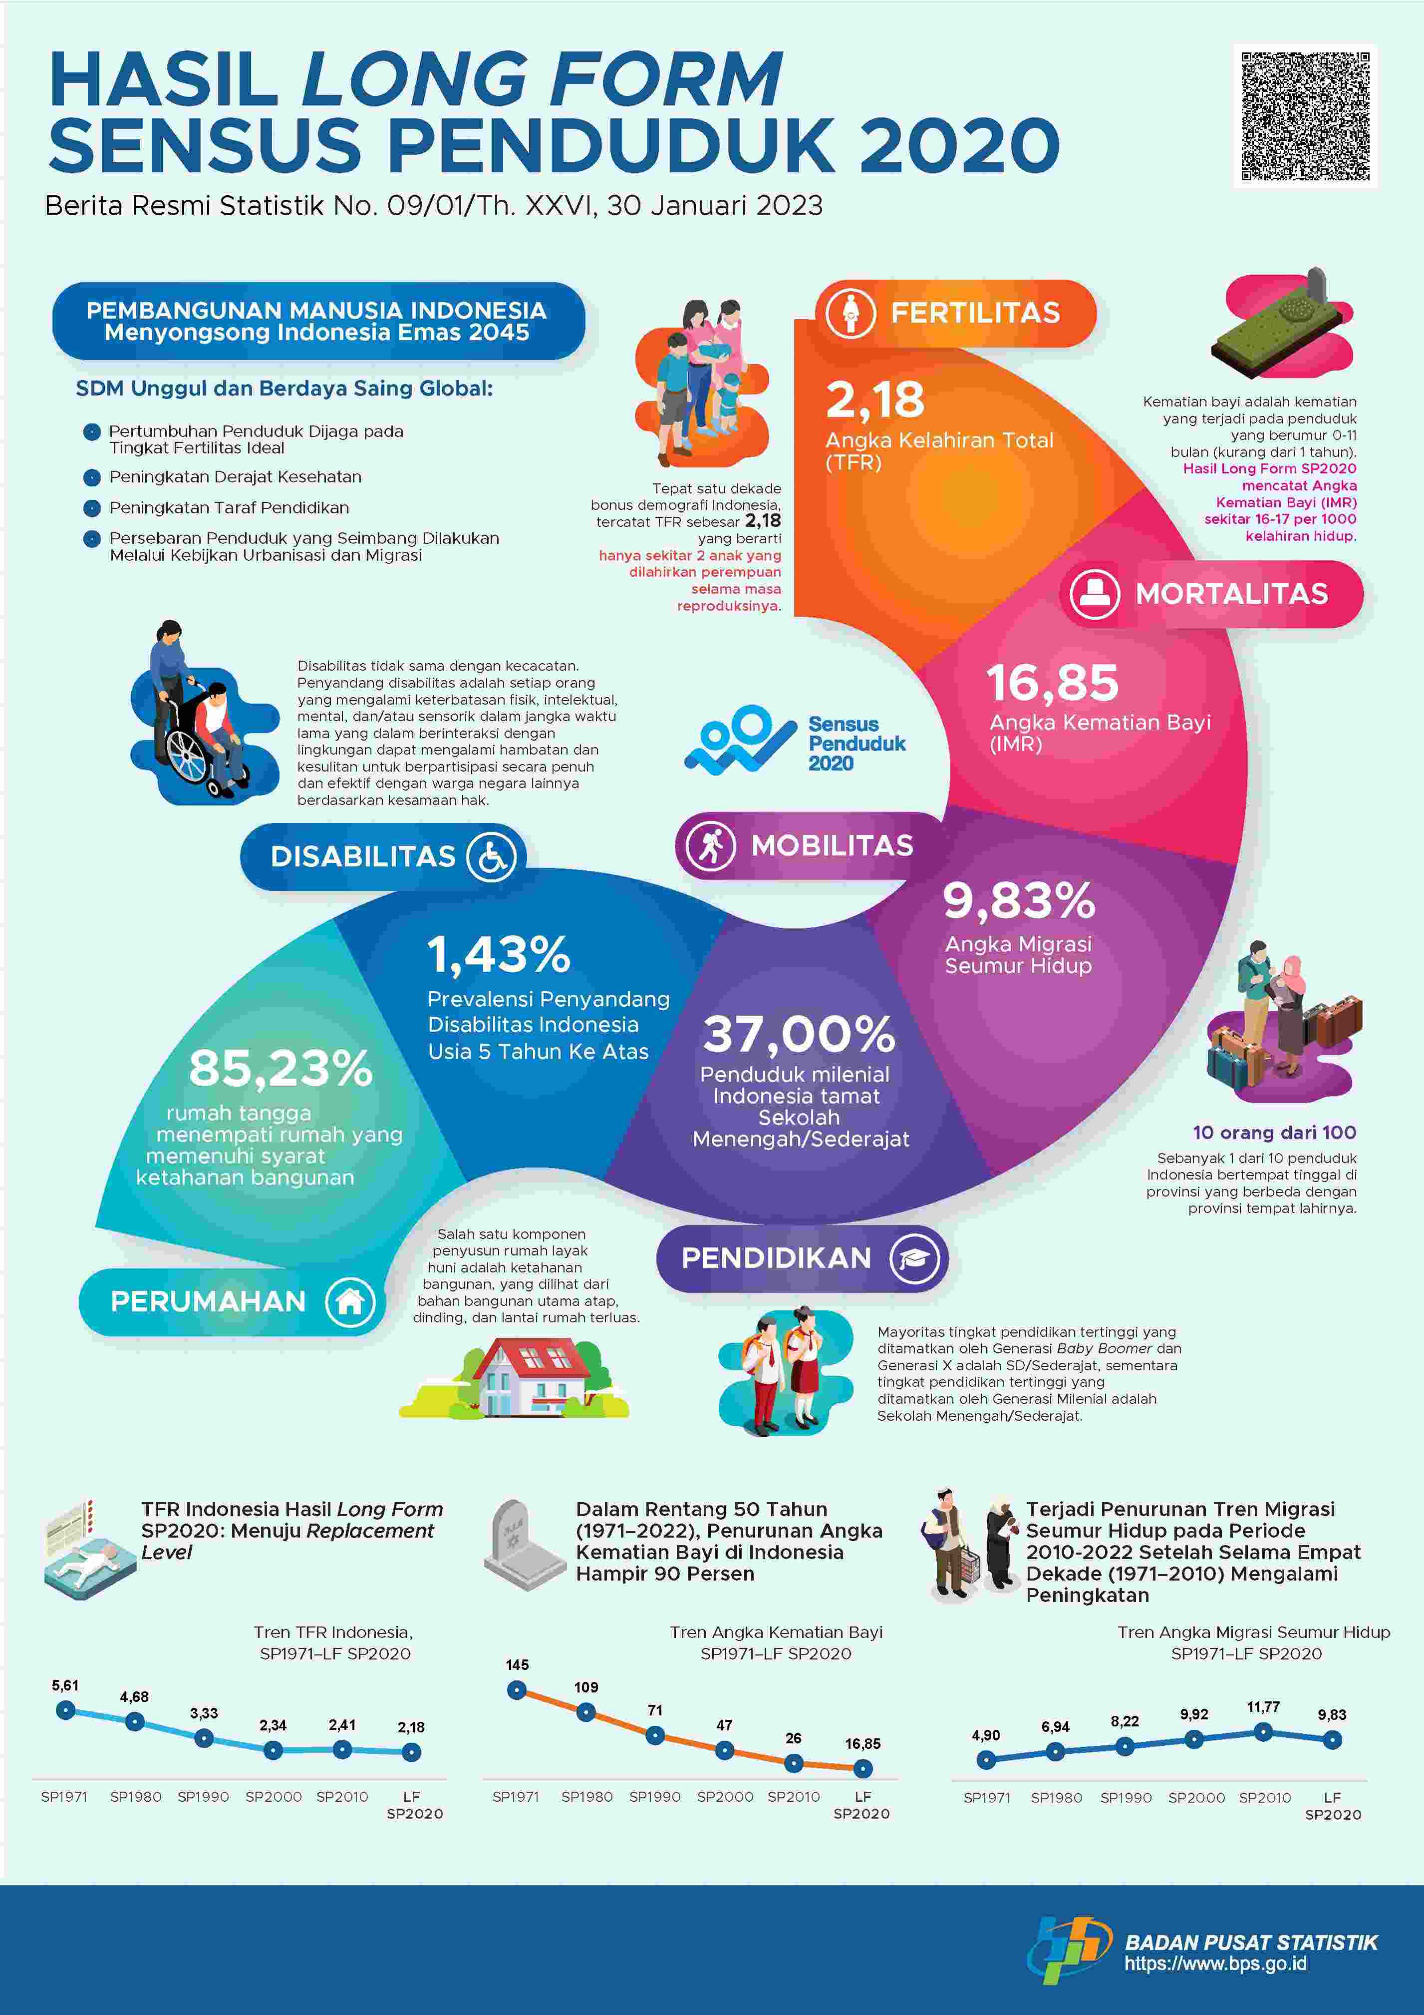
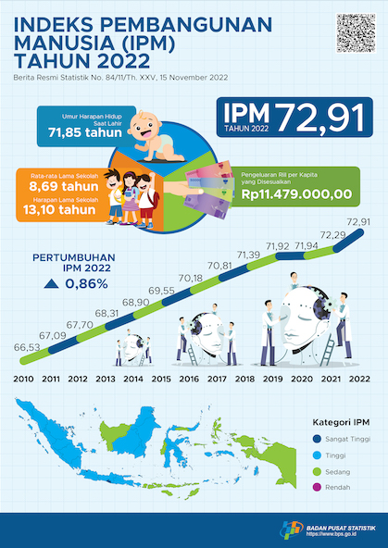

Slide 6
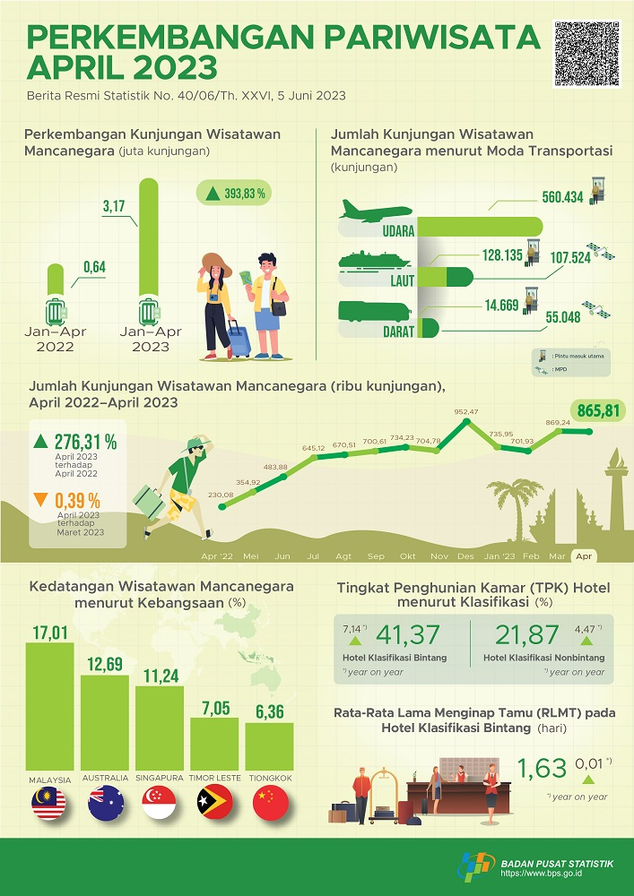
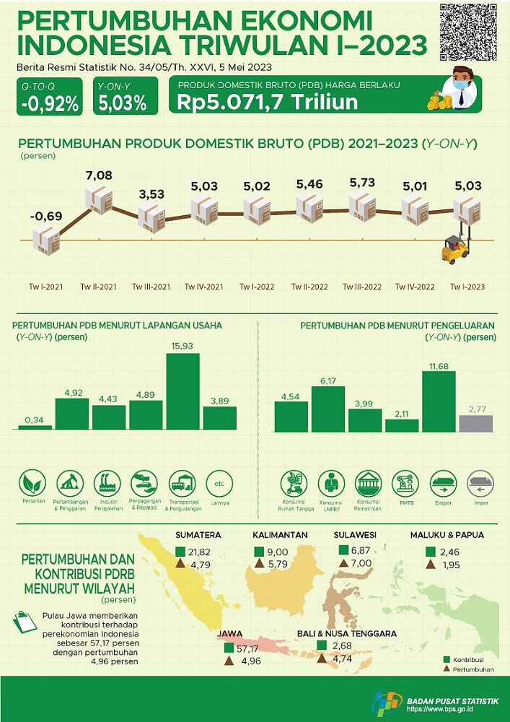

Slide 7
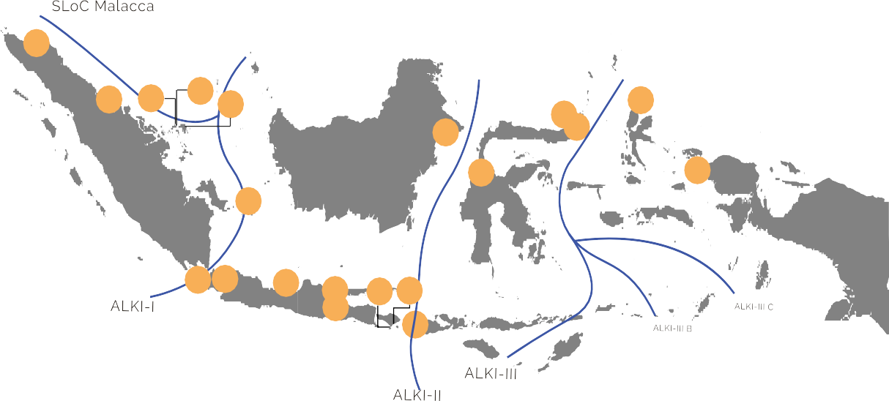
Kementerian Koordinator Bidang Perekonomian Republik Indonesia
Strategi
Kebijakan
KAWASAN EKONOMI KHUSUS (KEK) UNTUK MENDORONG PERTUMBUHAN EKONOMI, PEMERATAAN PEMBANGUNAN, DAN MENINGKATKAN DAYA SAING
20 Distribusi KEK
Pencapaian KEK
1. KEK Arun Lhokseumawe 11. KEK Singhasari 12. KEK Sanur 13. KEK Kura-Kura Bali 14. KEK Mandalika 15. KEK MBTK 16. KEK Palu
Aceh Utara & Lhokseumawe, Aceh |  | Kab. Malang, Jawa Timur |  | Denpasar, Bali |  | Denpasar, Bali | Kab. Lombok Tengah, NTB |  | Kab. Kutai Timur, Kalimantan Timur |  | Kota Palu, Sulawesi Tengah
(PP No. 5/2017 - Februari 2017) |  | (PP No. 68/2019 - September |  | (PP No. 41/2022 |  | (PP No. 23/2023 - April 2023) | (PP No. 52/2014 - Juni 2014) |  | (PP No. 85/2014 - Oktober 2014) |  | (PP No. 31/2014 - Mei 2014)
Pengembangan KEK telah berjalan dengan capaian investasi hingga Q1 2023 sebesar Rp4,6 triliun dan penyerapan tenaga kerja Sebanyak 7.738 orang.
Pencapaian kumulatif hingga 2023:
  Realisasi investasi sebesar Rp117,8 triliun
  Penyerapan tenaga kerja Sebanyak 63.416 orang
Target investasi dan tenaga kerja tahun 2023:
  Investasi sebesar Rp61,9 triliun
  Penyerapan tenaga kerja Sebanyak 78.774 orang.
Beroperasi Desember 2018 | 2019) | - November 2022) | Kegiatan Utama: | Beroperasi Oktober 2017 | Beroperasi April 2019 | Beroperasi Septe
Kegiatan Utama: | Kegiatan Utama: | Kegiatan Utama: | - Pariwisata | Kegiatan Utama: | Kegiatan Utama: | Kegiatan Utama:
mber 2017
- Industri Energi
- Industri Petrokimia dan Kimia Lainnya
- Industri Pengolahan Kelapa Sawit
Industri Pengolahan Kayu
Logistik
- Pariwisata
- Pengembangan Teknologi
- Kesehatan
- Pariwisata
- Industri Kreatif
Pariwisata
- Industri Pengolahan Kelapa Sawit
- Industri Energi
- Logistik
- Industri Logam Dasar
- Logistik
17. KEK Likupang
Kab. Minahasa Utara,
Sulawesi Utara
(PP No. 84/2019 - Desember 2019)
Kegiatan Utama: Pariwisata
2. KEK Sei Mangkei
1
Kab. Simalungun, Sumatera Utara (PP No. 29/2012 - Februari 2012) Beroperasi Januari 2015
Kegiatan Utama:
Industri Pengolahan Kelapa Sawit
Industri Pengolahan Karet
Pariwisata
Logistik
2
3
4
5
19
15
17
18
18. KEK Bitung
16
20
Kota Bitung, Sulawesi Utara (PP No. 32/2014 - Mei 2014)
Beroperasi April 2019
Kegiatan Utama:
Industri Pengolahan Kelapa
Industri Pengolahan Perikanan
Logistik
3. KEK Batam Aero Technic
6
Kota Batam, Kepulauan Riau (PP No. 67/2021 - Juni 2021)
Kegiatan Utama:
- Industri MRO (Maintenance, Repair, Overhaul) Pesawat
7
8
9
10
11
12 13
19. KEK Morotai
14
Kab. Pulau Morotai, Maluku Utara (PP No. 50/2014 - Juni 2014)
Beroperasi April 2019
Kegiatan Utama:
Industri Pengolahan Perikanan
Pariwisata
Logistik
4. KEK Nongsa
Kota Batam, Kepulauan Riau
(PP No. 68/2021 - Juni 2021)
Kegiatan Utama:
IT-digital
Pariwisata
5. KEK Galang Batang
6. KEK Tanjung Kelayang
7. KEK Tanjung Lesung
8. KEK Lido
9. KEK Kendal
10. KEK Gresik
20. KEK Sorong
Kab. Bintan, Kepulauan Riau (PP No. 42/2017 - Oktober 2017) Beroperasi Desember 2018
Kegiatan Utama:
- Industri Pengolahan Bauksit
- Logistik
Kab. Belitung, Bangka Belitung (PP No. 6/2016 - Maret 2016)
Beroperasi Maret 2019
Kegiatan Utama: Pariwisata
Kab. Pandeglang, Banten
(PP No. 26/2012 - Februari 2012)
Beroperasi Februari 2015
Kegiatan Utama: Pariwisata
Bogor, Jawa Barat Kab. Kendal, Jawa Tengah
(PP No. 69/2021 - Juni 2021) (PP No. 85/2019 - Desember 2019)
Kab. Gresik, Jawa Timur
(PP No. 71/2021 - Juni 2021)
Kegiatan Utama:
-Indusri Metal
Sorong, Papua Barat
(PP No. 31/2016 - Agustus 2016) Beroperasi Oktober 2019
Kegiatan Utama:
- Industri Pengolahan Nikel
- Industri Pengolahan Kelapa Sawit
Industri Hasil Hutan dan Perkebunan (Sagu)
Logistik
Kegiatan Utama:
- Pariwisata
- Industri Kreatif
Beroperasi Mei 2021
Kegiatan Utama:
-
- Industri Tekstil dan Busana
- Industri Elektronik
- Industri Furnitur dan Alat Permainan _{- Industri Kimia}
Industri Makanan dan minuman
Industri Otomotif
Industri Elektronik Logistik
Industri Energi
Logistik

Slide 8

Identifying Tourism Opportunity
after Covid-19 Pandemi
These are some future tourism opportunity that will prosper
Nature Tourism, Culinary Culture, History, Sports, Wellness Coastal and Marine Tourism
The last three Tourism Product are presently in need for more exposure and focus from all of us
1.Marine and Coastal 2.Wellness. 3.Sports Tourism
They will become the most lucrative Tourism Product in the next decade.
4 Tourism 2023 Megatrends have presently Influenced the Global Tourist Behavior, leading to tourism trends changes.
These 4 behavior cannot be separated from the latest phenomenon in the tourism industry, the revenge tourism

Slide 9
The FOUR Tourism Megatren in 2023,
“End of Ambition” , indicating a paradigm shift at work. Instead of only focusing on "work-and-work", people are starting to prioritize flexibility and healing for refreshing. In the future, this paradigm shift can boost the popularity of health and wellness tourism.
“Embellished Escapism” This tourism trend is based on the desire of tourists to seek a unique vacation experience. Tourism sectors must continue to innovate and adapt to create different holiday experiences. For example, by optimizing sports tourism destinations, to provide a memorable experience.
“Always in Doubt”. This consumers or tourists behavior who are starting to be skeptical about the tourism sector. Due to availability of ratings and honest reviews on every tourist destination they will visit, where they will find travel information that is truly clear and reliable. Therefore, all tourism actors must be more honest and improve the quality of service in building tourist trust.
“Polycentric Lifestyle”. This tourism trend is based on the desire of tourists to find the uniqueness and attractiveness of each area to be visited. Thus, the tourism industry should start highlighting the characteristics it has whether it is in terms of natural beauty, art, and culture that are still well preserved. This aims to attract the attention of tourists to visit.
4 Megatren Pariwisata 2023, Pengaruhi Perilaku Wisatawan Global (kemenparekraf.go.id)

Slide 10
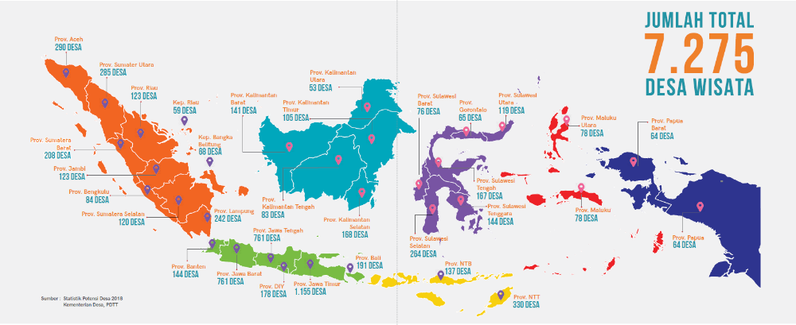
Staycation - Embraced at the 7275 “Desa Wisata”
Sumber; buku panduan desa wisata 2021, Kementerian Koordinator Bidang Kemaritiman dan Investasi Republik Indonesia

Slide 11
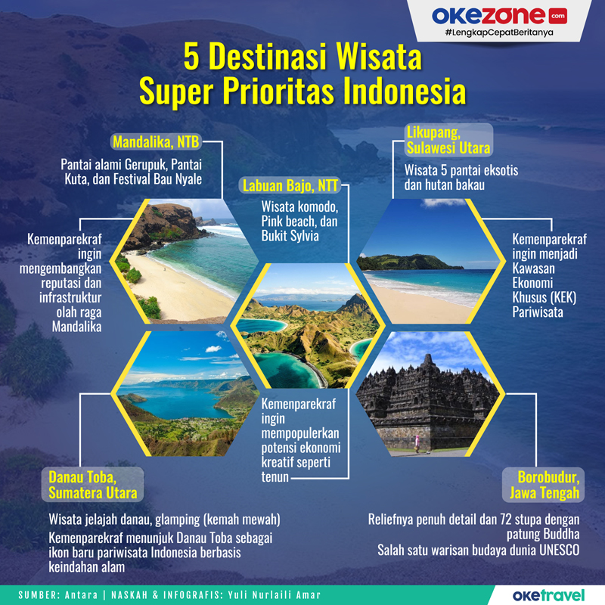
10 Indonesia’s Priority
Tourisme Destination
1. Mandalika, West Nusa Tenggara
2. Pulau Morotai, North Maluku
3. Tanjung Kelayang, Bangka Belitung .
4. Lake Toba, North Sumatera
5. Wakatobi, Southeast Sulawesi .
6. Borobudur, Central Jawa
7. Kepulauan Seribu, DKI Jakarta .
8. Tanjung Lesung, Banten .
9. Bromo, East Jawa .
10. Labuan Bajo, East Nusa Tenggara
8 out of 10 are Maritim Tourism
https://kemenparekraf.go.id/rumah-difabel/Mengenal-10-Destinasi-Prioritas-Pariwisata-Indonesia

Slide 12

Identifying Maritime and Coastal Tourism Opportunity
Indonesia has around 17.640 island , on an area of 1.904.659 Km2 , and 99.083 Kilometer of coastal beach.
The preference between developing a maritime island cluster or integrating a Desa Wisata would depend on various factors, including market dynamics, investment goals, target audience, and personal values and the following aspect:
There is a strong market demand for luxury tourism experiences.
The investor has experience and resources in the low to high-end hospitality industry.
The location and infrastructure of the island are suitable for large-scale resort project.
The investor is targeting high-spending tourists who seek exclusivity, luxury and long stayer.
On the other hand, integrating it to a Desa Wisata may be preferred if:
The investor values sustainability, community engagement, and cultural preservation.
There is a market demand for authentic and immersive cultural experiences.
The investor wants to support and empower local communities.
The location and cultural heritage lend themselves well to the Desa Wisata concept.
Ultimately, it depend on the investor's objectives, market research, and understanding the target audience. It's also worth considering that elements of both concepts can be combined to create a unique and differentiated tourism offering that caters to various market segments. A thorough market analysis, feasibility studies, and financial assessments to determine the potential return on investment and alignment with the investor's goals.

Slide 13
Benefit of Maritime and Coastal Tourism
Maritime tourism is the sector of the tourism industry that is based on tourists and visitors taking part in active, passive leisure, holidays pursuits and journeys on ocean, seas, coastal waters, their shorelines, river, lake and their immediate hinterlands.
Maritime or Nautical or Water Tourism involve Water sports, Diving, Yacht Snorkeling, Fishing, Sailing, Boating, Cruise Ship, Regatta, Ecotourism
It generate higher revenue and impact to the surrounding per client, compare to land tourism. Should be implemented ASAP
The impact of every Nautical tourist - 2 to 6 direct jobs and 9 to 15 indirect ones
It can improve environment sustainability and marine / wildlife protection
Marine tourism helps local communities to improve their livelihoods. It create employment opportunities, better local communities, local supply chains, and promote cultural heritages.
It will induce new hotel, restaurant, housing, community development in the long run. Pre Fabricated Hotels and Marinas will be valuable
Indonesia has the highest Marine diversity in the world, type of corals, fish, plankton etc. of benefit and interest for nautical travelers.
When done the right way, it can generate more revenue and employment compared to the fishery, oil, shipping industry
Nautical tourists bring demand for variety of goods and services, as they live on their ships / boat. Marinas are developed especially for nautical tourists to replenish their provisions. Develop as many Marinas as possible.

Slide 14



Footpath in creating Maritime and Coastal Tourism
Here are some key aspects to consider:
Location and Geography: white beaches, clear waters, reef.
Infrastructure: transportation, quick to build accommodation, marinas, housing complex, sea/ocean toll traffic and utilities.
Environmental Preservation: implementing sustainable practices. Protect and restore ecosystems. Educate the importance of conservation and promote responsible tourism.
Beach Development: Enhance existing beaches, create artificial ones if necessary, maintain cleanliness, waste management
Underwater Attractions: showcase the marine biodiversity.
Quick Build Hotels, Water Villas and Overwater Bungalows:.
Tourism Facilities: recreational activities, spas, water sport center, restaurants, beach clubs, dining options cuisines.
Marketing and Promotion: strategy to attract tourists with unique features and experiences, online platforms, social media.
Training and Hospitality: Foster a culture of warm hospitality and attentive customer service.
Government Support: Collaborate on permits, regulations, and investment incentives, Ports and Marinas.
By focusing on creating a beautiful island destination with high-quality tourism facilities and services, you can attract island hopping visitors in an Indonesian setting.

Slide 15

Indonesia’s Maritime tourism to the future.
It is a vulnerable tourism. Affected by environment, dependent to climate and provision supply. Prepare proper infrastructure, port, marina, sea toll.
Providing a favorable investment environment, offering incentives, ensuring regulatory clarity that can help attract investors and facilitate their participation in the project.
To attract serious investment, it is essential to develop a compelling business case, demonstrate market potential, and highlight the unique selling points of the destination.
Capacity Building in Developing the Human Capital, by learning, training, vocational development, either off line, hybrid or on line .
Government to spend more resources in Marketing, Promotion, Publicity, Digital Marcom, Social Media with professional entities.
Environmental Protection and Conservation
Public-Private Partnerships
Infrastructure Planning and Zoning
Tourism Safety and Security
Collaboration with International Partnerships, to gain expertise, share best practices.

Slide 16
Improving Opportunity for Maritime Tourism
Zoom in on the eastern part of Bali and all Outermost islands of Indonesia
Improve Sea/Ocean Toll traffic for provision distribution
Central government regulation in speeding up Maritime Tourism
Central government to create a master plan, that include each province task in making this program a success
Learn from Maldives, Polynesia, Seychelles success story in Maritime Tourism
Build industries to sustain Maritim Tourism, such as quick to build marinas, pre fab hotels, housing and boat fabrication
Start to focus in Human Development, in preparing local talents in working in the hospitality industry. Create on line learning programs to reach remote area
Most importantly to review and redevelop the Central Government Marketing Strategy in promoting remote tourism area / destination, specially related to Maritime tourism
Decide location for Marinas and its supporting infrastructure around Indonesia, which will attract international Maritime tourist
Simplify permits for international boat , cruises and vessels to enter Indonesia
Increase number of small airports to become as feeders to Maritime Tourism destinations

Slide 17
Taped bu Untaped Maritim and Highlands of Indonesia
Raja Ampat Islands, in West Papua, Raja Ampat, with its breathtaking natural beauty, of pristine turquoise waters, vibrant coral reefs, and lush rainforests. Known world-class diving and snorkeling, an abundance of marine life and coral biodiversity.
Wakatobi National Park, in Southeast Sulawesi, a hidden divers gem and snorkelers , pristine coral reefs, vibrant marine life, great visibility,natural beauty and biodiversity.
Togean Islands in Central Sulawesi, known as a secluded and tranquil getaway, coral reefs, white sandy beaches and dense jungles and lakes.
Komodo National Park a Komodo dragons UNESCO World Heritage site. The parkand Rinca Island encompasses several islands with diverse wildlife, stunning landscapes.
Lake Toba and Samosir Island , in North Sumatra, is the largest volcanic lake in the world, serene setting, lush mountains and traditional Batak villages..
Toraja Highlands in South Sulawesi, known for their unique culture and stunning landscapes, elaborate funeral ceremonies, terraced rice fields and valley hiking
Bromo Tengger Semeru National Park in East Java, famous for its landscapes and volcanic formations, best place to witness the sunrise, hike to Mount Semeru, explore the vast sand sea and picturesque savannah.
Outermost Island. 1.Natuna Island, 2. Marimpit Island, North Sulawesi., 3.Rote Island,in the Sawi Sea, by the Indian Ocean. 4. Miangas Island near the Philippines in Kepulauan Talau. 5. Pulau Weh is on the western tip of Aceh, Indonesia. 6. Liki Island. directly facing the Pacific Ocean. Let’s go “ISLAND HOPPING”
These examples highlight the diverse and lesser-known destinations in Indonesia that offer unique experiences and natural wonders. Exploring these untapped regions allows travelers to discover the rich cultural heritage, biodiversity, and natural beauty that make Indonesia a truly remarkable Maritime destination.

Slide 18


Terima Kasih
Alexander Nayoan
Joko Haryono
BPP PHRI
Grand Sahid Jaya Hotel Shopping Arcade #04-05
Jalan Sudirman 86, Karet Tengsin
Jakarta Pusat - 10220

Slide 20
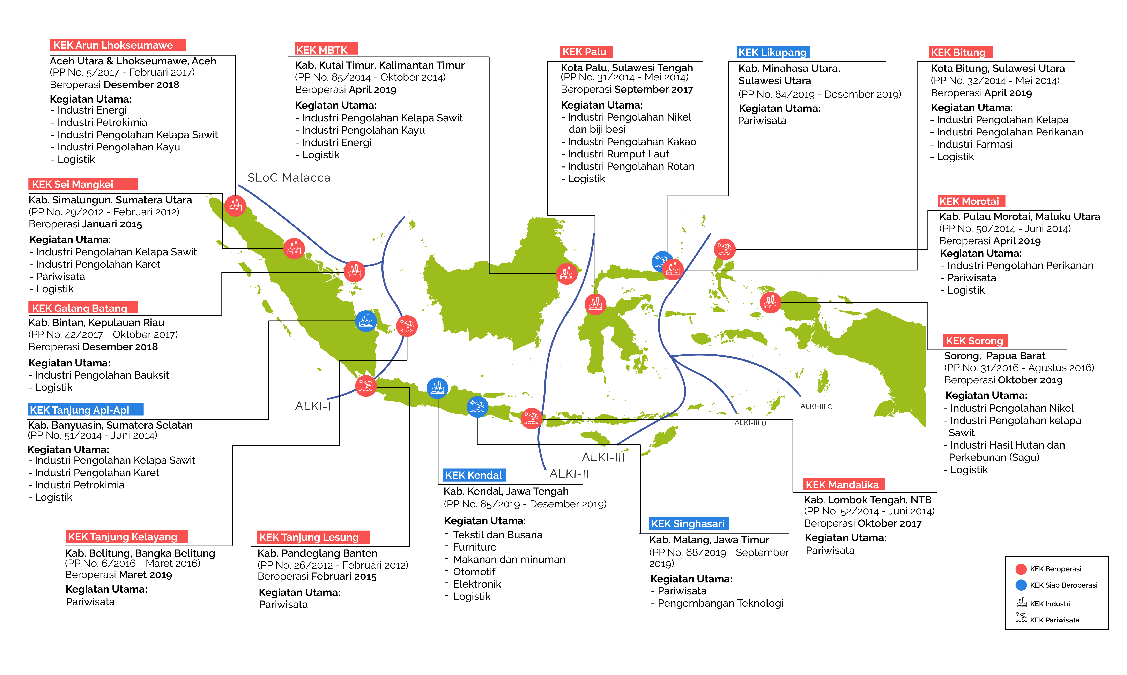
http://pariwisata.kepulauanselayarkab.go.id/wp-content/uploads/2020/09/Peta-Sebaran-KEK-Indonesia_20200217153755.png -- 16/5

