Slide 1


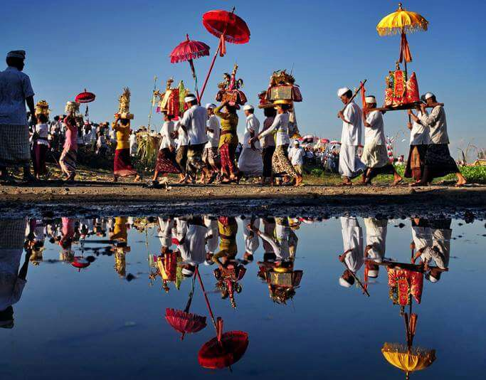
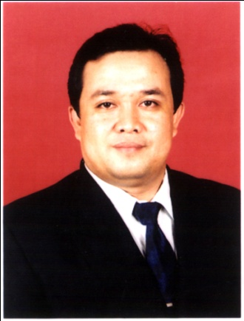
Sustainable Indonesian Tourism;
DR. GUSTI KADE SUTAWA, SE.,MM.,MBA
The President of Nawa Cita Pariwisata Indonesia
Lecture at The International Institute of Tourism and Business
The Chairman of Bali Tourism Community Alliance
Member of Tourism Expert Team of Bali Province
Director/CEO of PT Saron Hotel Management
Advisory board member of Bali Chamber of Commerce and Trade, IHGMA Central Board, HAMI Bali, APINDO Bali, IHRA Badung Chapter, HKTI Bali, Etc
@ Gusde’2023

Slide 2
Environmental Conservation: Sustainable Tourism Capital
Orientation of Sustainable tourism development
Socio-Cultural continuity
Economic continuity
Ecological sustainability

Slide 3
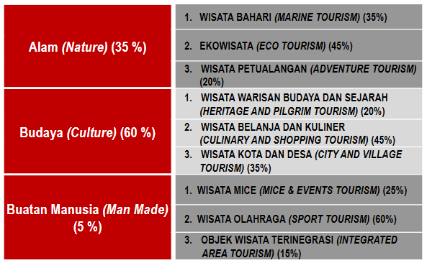

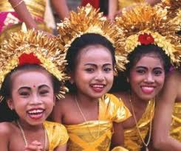

THE MAIN PRODUCTS OF INDONESIAN TOURISM

Slide 4
CULTURAL TOURISM OF INDONESIA
Cultural Tourism of Indonesia is in accordance with the mandate Law Number 10 of 2009 concerning tourism where in its consideration it is stated that one of the resources and capital for Indonesia’s tourism developmet is art and culture other than nature, flora,fauna,ancient relics and hisorical relics.

Slide 5
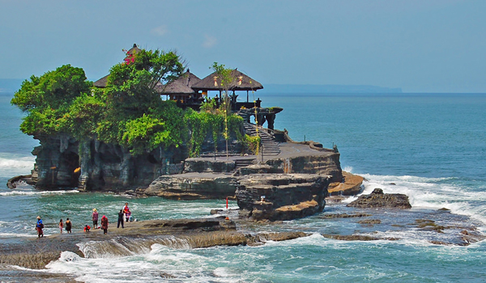
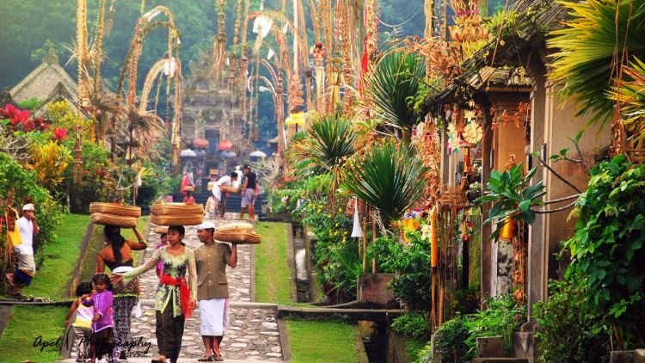
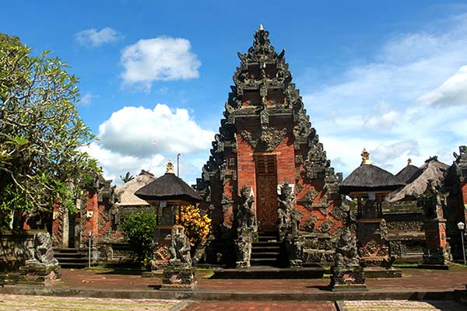
Cultural Tourism
The various of cultural object tourism
are:
Archaeological sites and museums,
Architecture,
Art (art), sculpture, crafts, cultural festivals,
Music and dance,
Drama ( theater, film),
Language and literature,
Religious ceremonies
Traditional culture (Ardika, 2004: 23)

Slide 6
Indonesian Tourism Update
-The number of foreign tourist visits to Indonesia in year 2022 is 5,47 million, up 251,28 percent compared to the umber of foreign tourist visits in year 202
-The target for foreign tourist arrivals in year 2023 is 7,4 tourist.The Goverment wants to icrease the target for foreign tourists arrivals to 8,5 million
-92 Countries already have Visa On Arrival facilities.

Slide 7
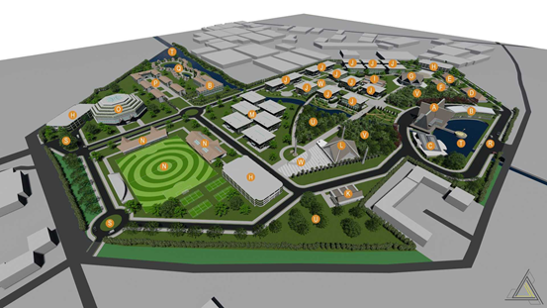
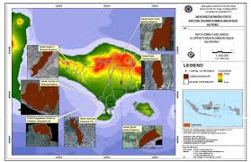
Inputs From Tourism Stakeholders for the development of
Indonesian Tourism
1. Tourism Master Plan / Blue print for All Provinces in Indonesia
2.The Central Government must be consistent and focus on cultural tourism as an icon in developing Indonesian tourism

Slide 8
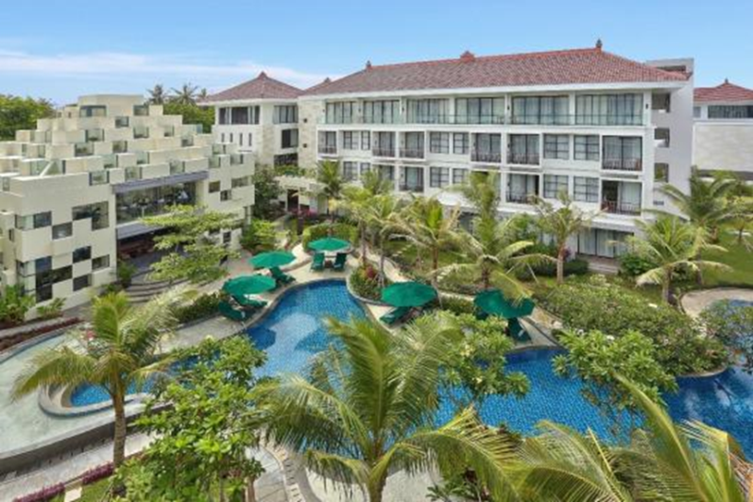
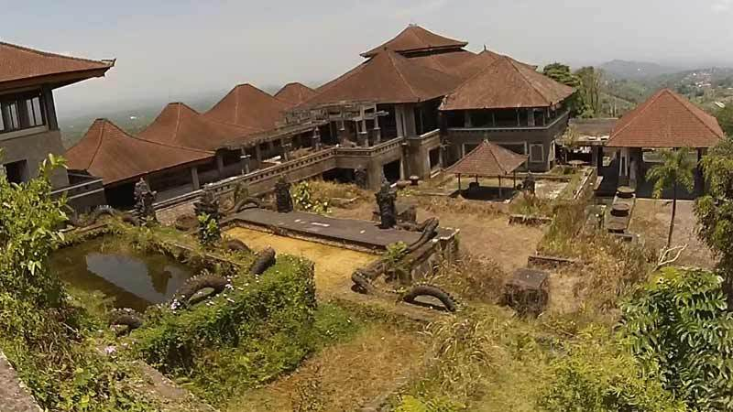
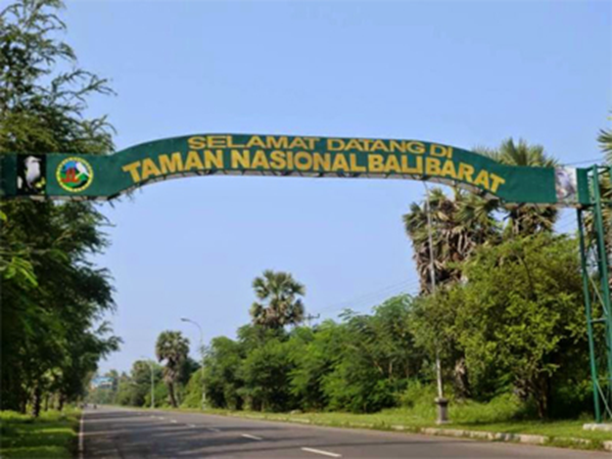
Input From Tourism Stakeholders for the development of
Indonesian Tourism
3. The concept of national tourism is needed, as praticed by former tourism minister I Gede Ardika.
4. State companies or state -owned entreprises that manage companies in tourism sectors to involve tourism professionals to become directors to ensure management is carried out in profesional manner.
5.The Ministy of tourism and creative economy to recruit more more tourismexperts to join the team.

Slide 9
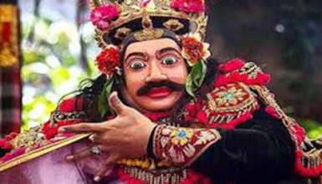
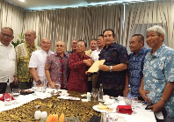
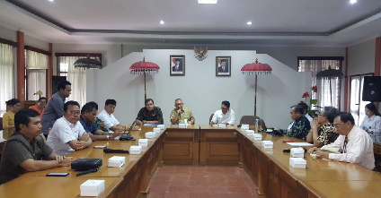
STAKEHOLDERS INVOLVEMENT
IN DEVELOPING SUSTAINABLE TOURISM
E
PRIVATE SECTOR
1.Increase In Socio-economic Welfare
GOVERNMENT
ACADEMICIAN
2.Social Cultural Embassies
SUSTAINA
BILITY TOURISM
MEDIA
LOCAL
COMMUNITY
NGO
3.Environmental Preservation
TOURISM SUSTAINABILITY
Synergy between the government and stakeholders is very important
Government and stakeholders meetings,discuss tourism issues and seek solutions if there are problems

Slide 10
Local Regulations Supporting Sustainable Tourism; Example of Bali Island ; Regulations such as the example below should also be and implemented in all provinces in Indonesia
Pergub No.97 tahun 2018 ;Pembatasan Timbunan Plastic Sekali Pakai (Single-Use Plastic disposal Restrictions)
Pergub No.79 tahun 2018:Hari Penggunaan Busana Adat Bali (The Use of Traditional Balinese Clothing)
Perda 5 tahun 2020; Standar Penyelenggaraan Kepariwisatan Budaya Bali (Standards for Implementing Balinese Culture Tourism)
Perda 28 tahun 2020, Tata Kelola Pariwisata Bali (Bali Tourism Governance)
Pergub 99 Tahun 2018:Pemasaran dan Pemanfaatan Produk Pertanian,Perikanan dan Industri Lokal (Marketing and Utilization of Agricultural, fishery and Local Industrial Products)
Perda 8 tahun 2019; Sistim Pertanian Organik (Organic Farming System)
Perda 1 tahun 2020;Kontribusi Wisatawan Untuk Pelindungan Alam lingkungan dan Budaya Bali (Contribution of Tourists to the Protection of Natural Environment and Culture of Bali)
Pergub 47 thun 2019; Pengelolaan Sampah Berbasis Sumber (Source- Based Waste Management)
Pergub 24 tahun 2018; Pelindungan Danau, Mata Air, Sungai dan Laut (Protection of Lakes, Springs, River and Seas)
Remarks ;Perda /Pergub is Local Regulation ,issued by Governor of Bali

Slide 11
How to make tourist destinations in Indonesia become tourist destinations that are in demand by foreign tourists and can be sustainable?
Consistent with cultural tourism as an icon; cultural uniqueness that is diverse and different in all regions in Indonesia continues to be preserved and developed to become a tourist attraction and promoted to foreign countries
Indonesia’s tourism promotion budget must be increased, because it is still very small, around 400 billion rupiah per year.Compared to Malaysia ,which budgets for promotion costs of around 1,2 trillion per year.
The government needs to involve all tourism stakeholders including airlines, hotels, travel agents, academics, tourism leaders,the media adn aother tourism actors in planning, developing and managing tourism.
It is better to form the Indonesian Tourism Board which is filled in by representatives of all existing tourism associations and figures who are tourism experts and government representatives.This is necesssary so that every decision taken is the result of a decision made by the goverment and industrys o that the results can be accepted by all parties

Slide 12
Conclusion
To ensure sustainability of Indonesian Tourism, , requires synergy between Government and all stakeholders.
Indonesia has 1340 ethnic groups and 7241 cultural works.With the many cutures that Indonesia has and each culture is unique, Indonesia will become a favourite tourist destination in the world if it makes culture a tourism icon
Indonesian Tourism will be sustainable if it pays attention to and maintains the environment, socio-culture and the welfare of the community wherever tourism is developed.
With the many violations by foreign tourist in Bali lately, both regarding customs, Balinese culture ,traffic and existing laws, the Government issued a new circular for foreign tourist while in Bali. It hoped that after the circular is inacted it can suppress violations from foreign tourist while in Bali.

Slide 13
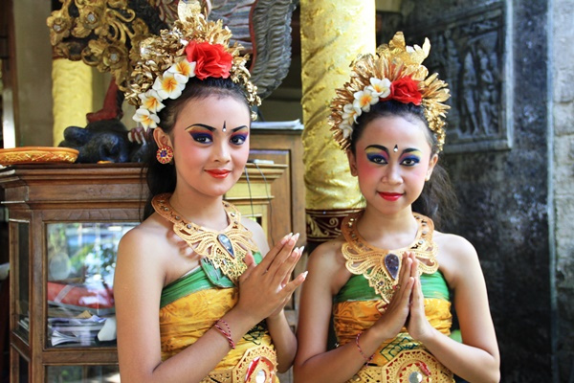

@ Goesde’2023
@ Gusde’2019

